Slide 1
Mini Project STQA
1. Kharmate Mayur Sambhaji
2. Uttekar Aniket Rajesh
3. Kudale Yash Satish
Guided by:
Prof. Anita Patil

Slide 2
Aim
Creating the Dynamic website of covid-19 information using HTML, CSS, JAVASCRIPT And PHP, MySQL database to store user account, comment, and registration form details. Regular Expression testcases for testing purpose

Slide 3
S/W to be used
Software Component | Details
Operating System | Windows 11
Output Software | Google Chrome
Frontend | HTML , CSS , JS
Database | MySQL
Server Side Language | PHP
Tool | XAMPP

Slide 4
H/W to be used
Hardware Component | Details
Processor | i7 10th gen , 2.4 GHz
Memory | 220 GB
Other (If Required) | 16 GB RAM

Slide 5
Introduction
Software Testing :
Testing is the process of evaluating a system or its components to find whether it satisfies the specified requirements or not.
Test Cases :
A Test Case is a set of actions executed to verify a particular feature or functionality of your software application. A Test Case contains test steps, test data, precondition, postcondition developed for specific test scenario to verify any requirement.
Regular Expression testcases :
A regular expression testcase is a pattern that is used to match in input text. A pattern consists of one or more character literals, operators, or constructs.

Slide 6
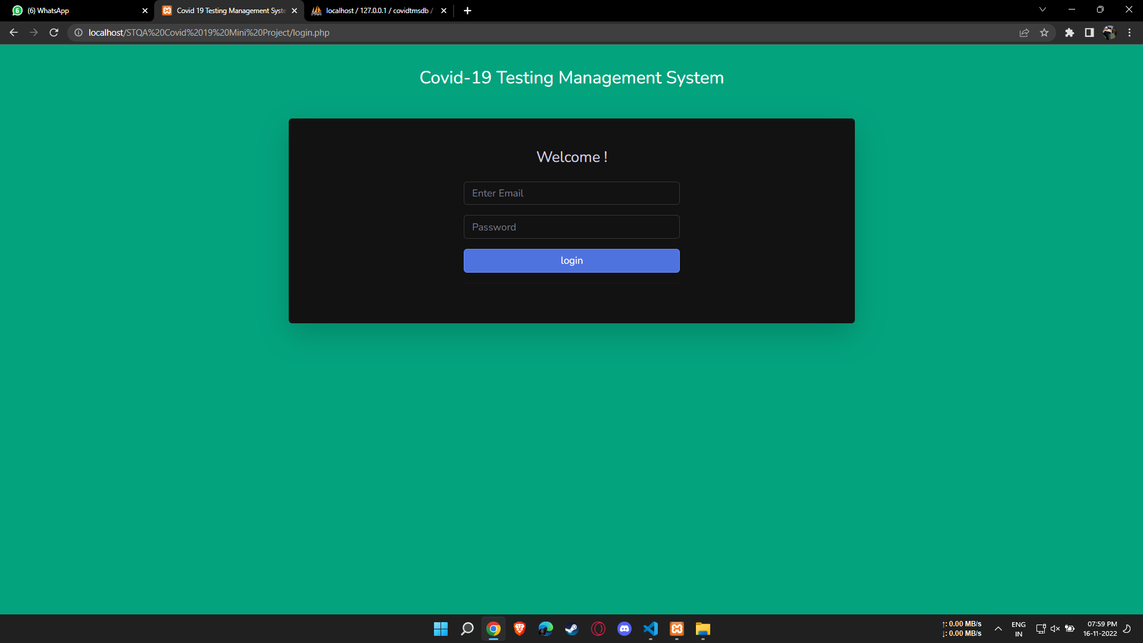
Evaluation :
1. Login page of Covid-19 Testing Management System : http://localhost/STQA Covid 19 Mini Project/login.php

Slide 7
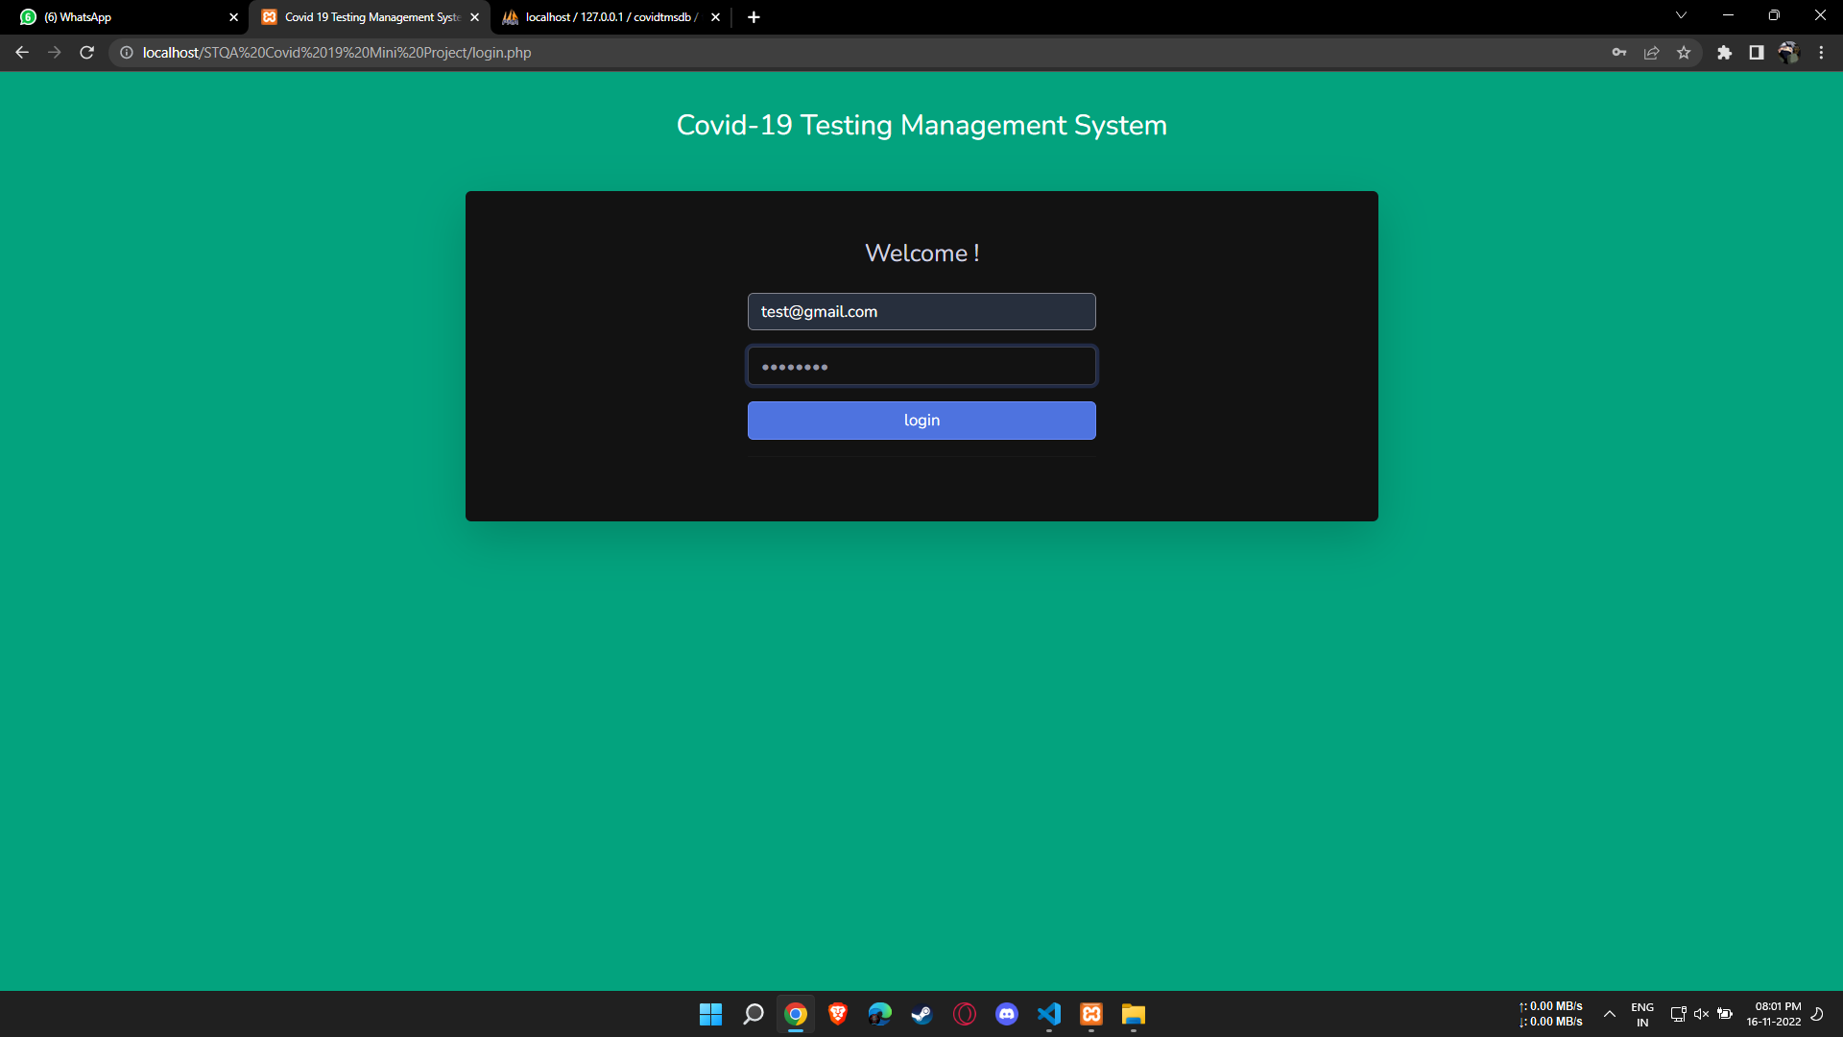
2. Filling Login details :

Slide 8
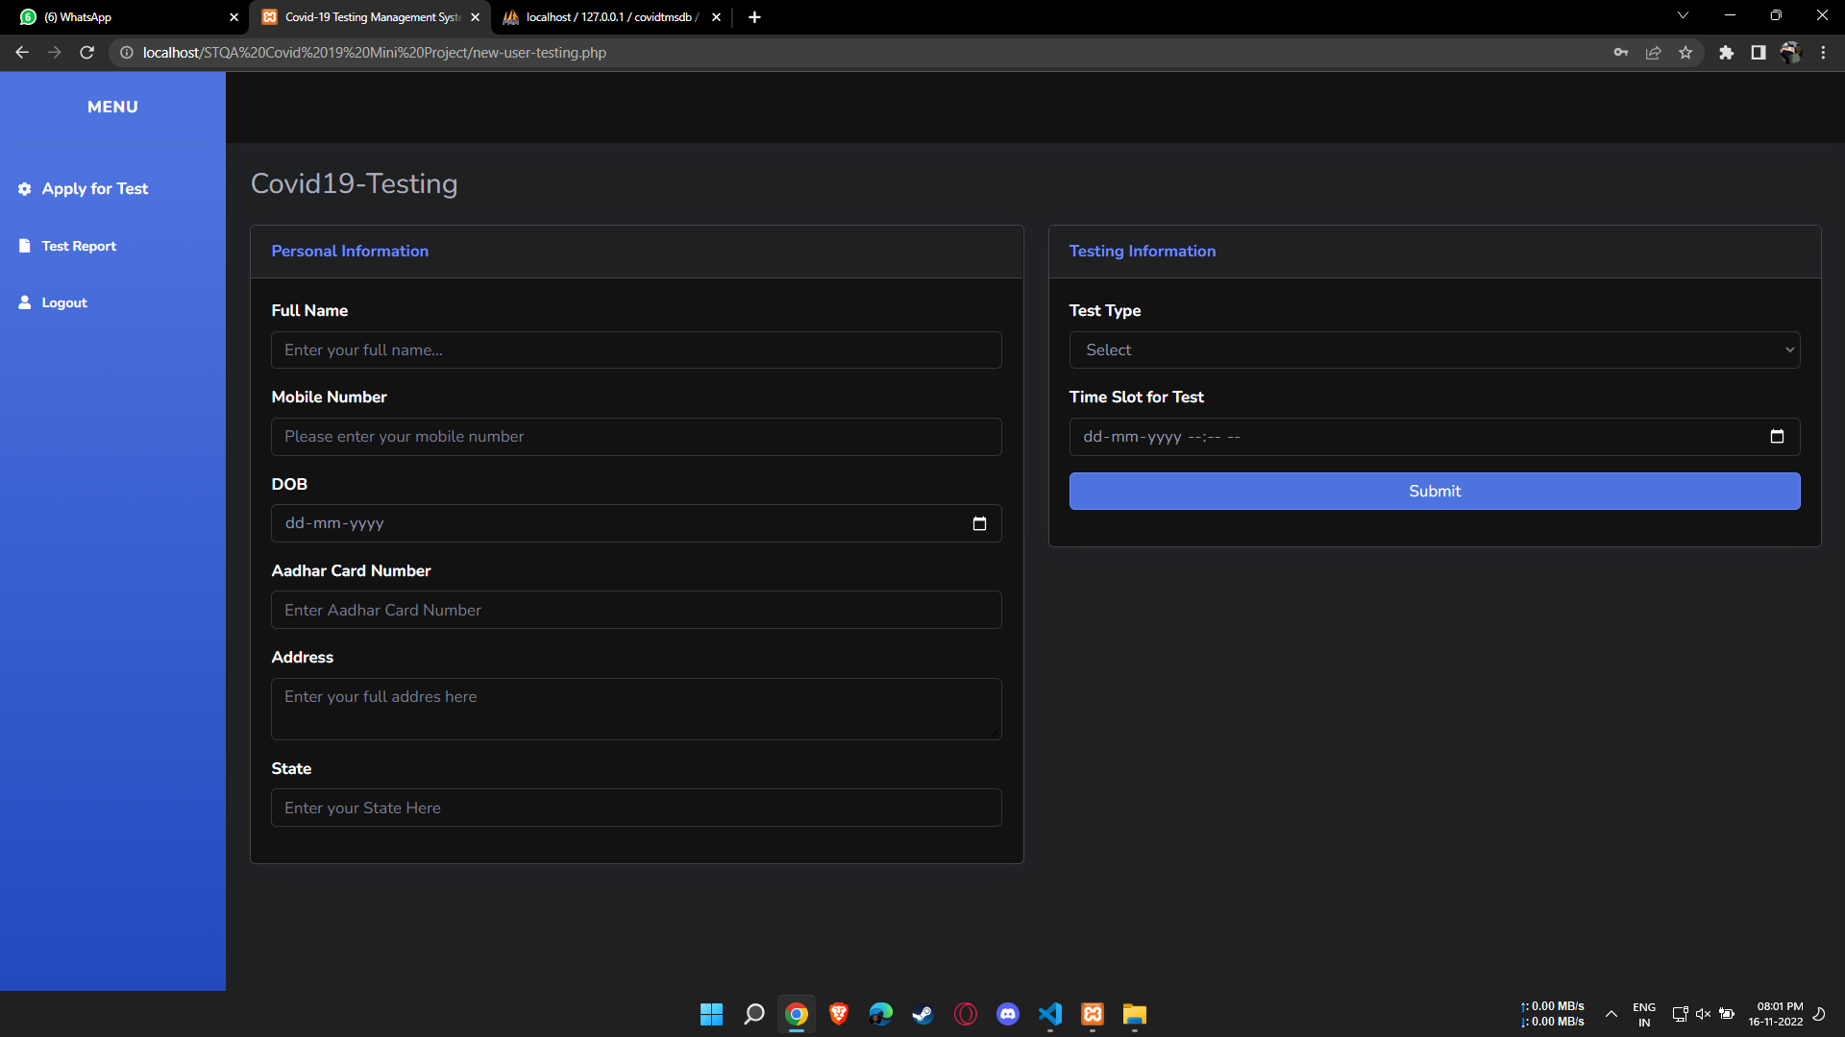
3. Registration Form :

Slide 9
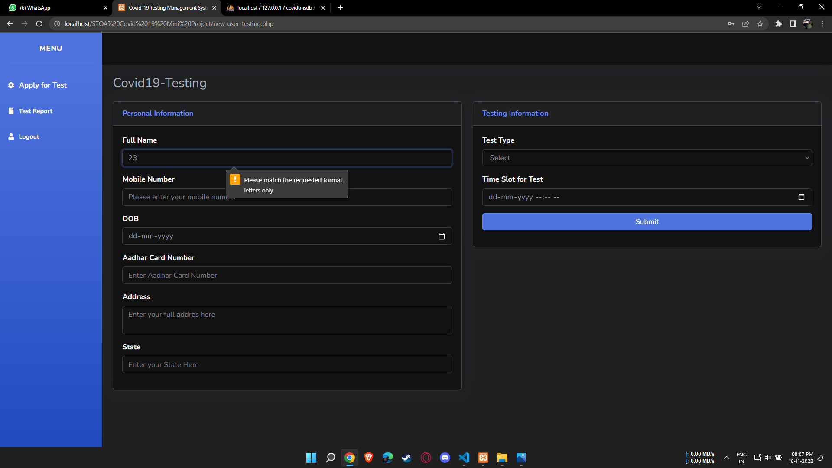
4. Full Name Regular Expression : [A-Za-z ]+

Slide 10
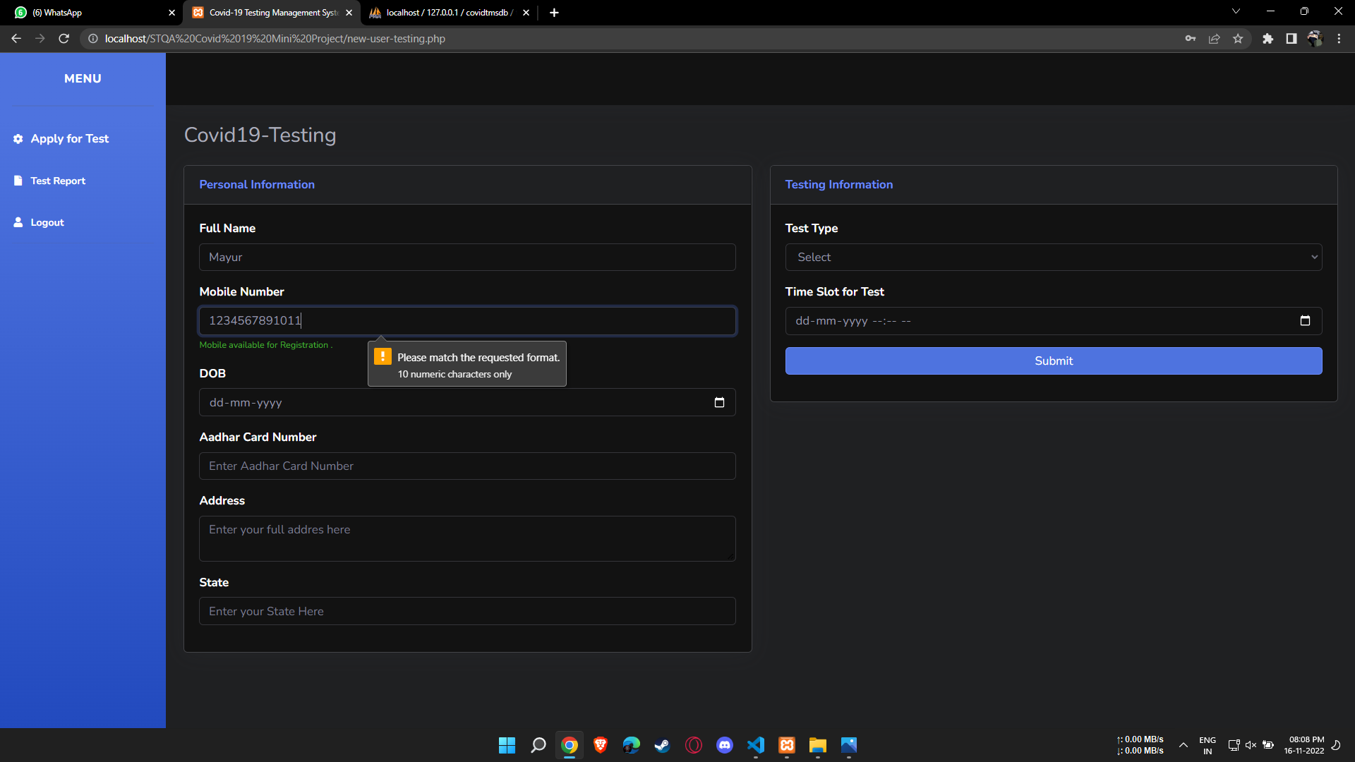
5. Mobile Number Regular Expression : [0-9]{10}

Slide 11
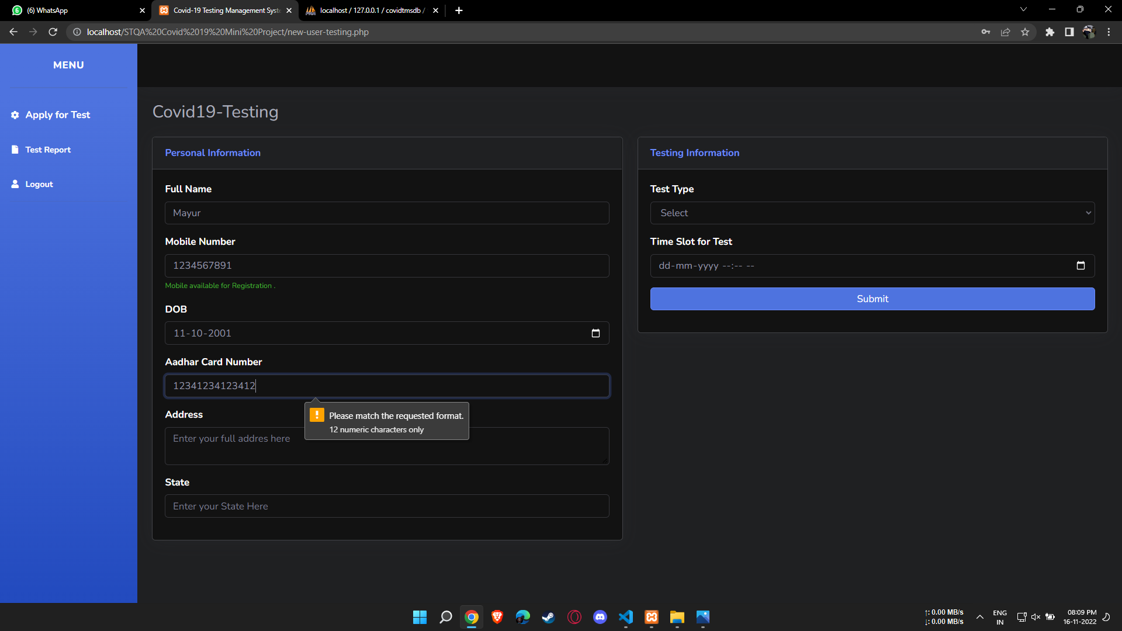
6. Aadhar Card Number Regular Expression : [0-9]{12}

Slide 12
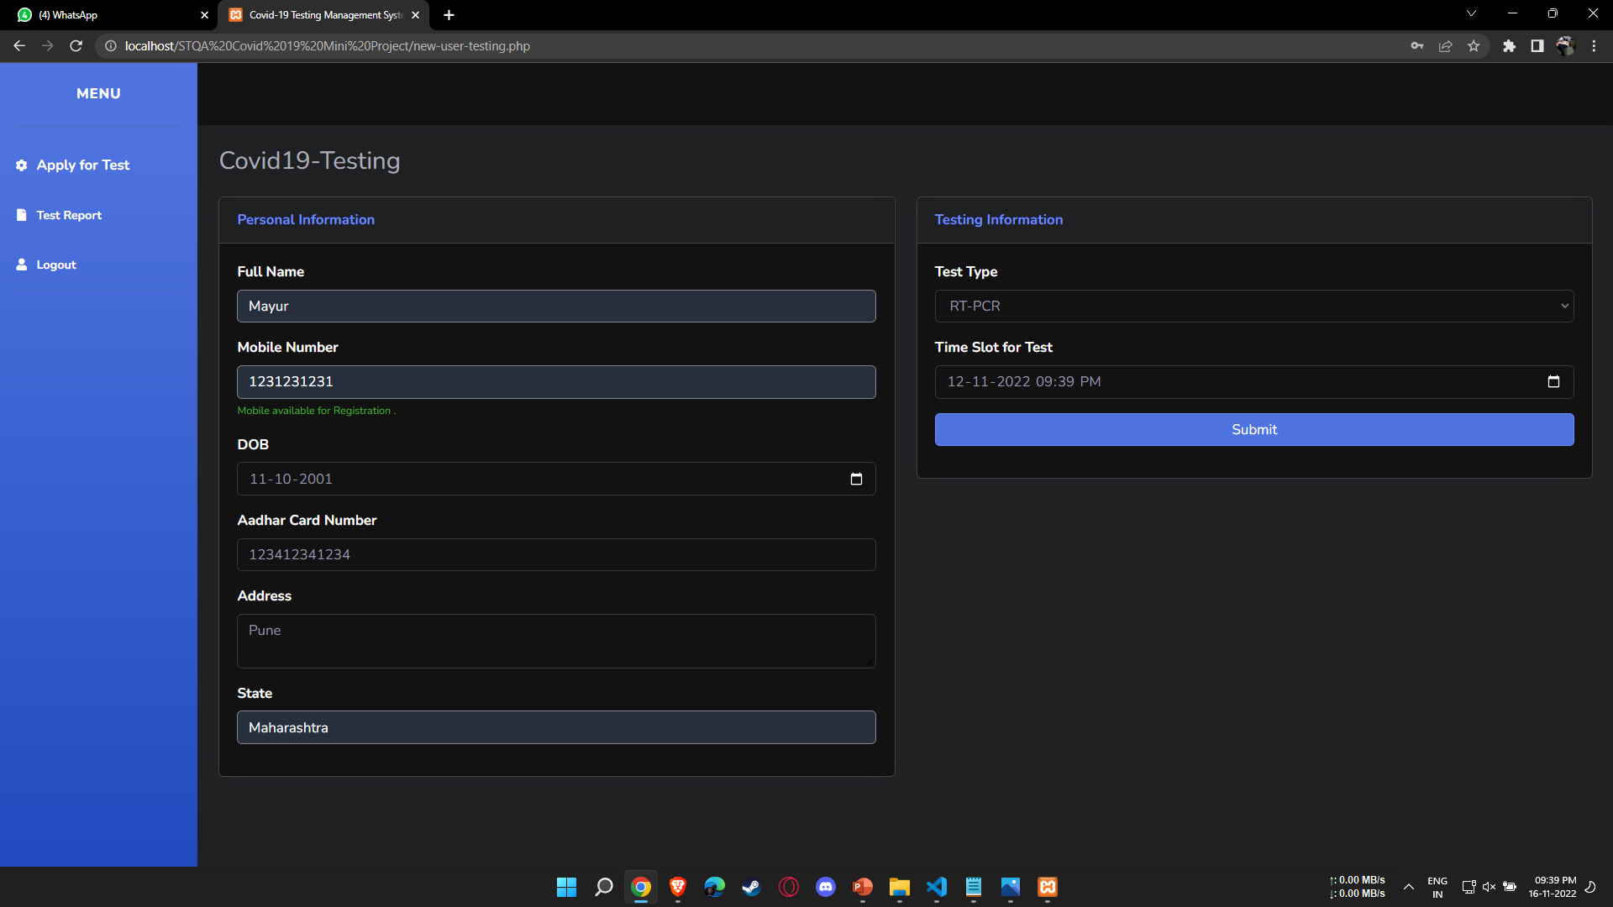
7. Filling Whole Form :

Slide 13
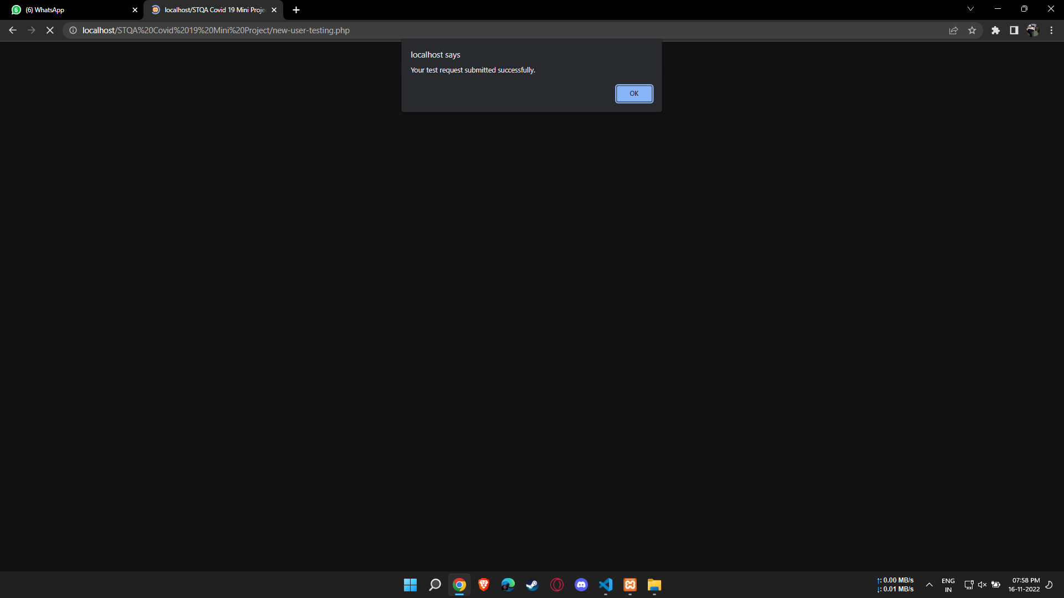
8. Submitting Form:

Slide 14
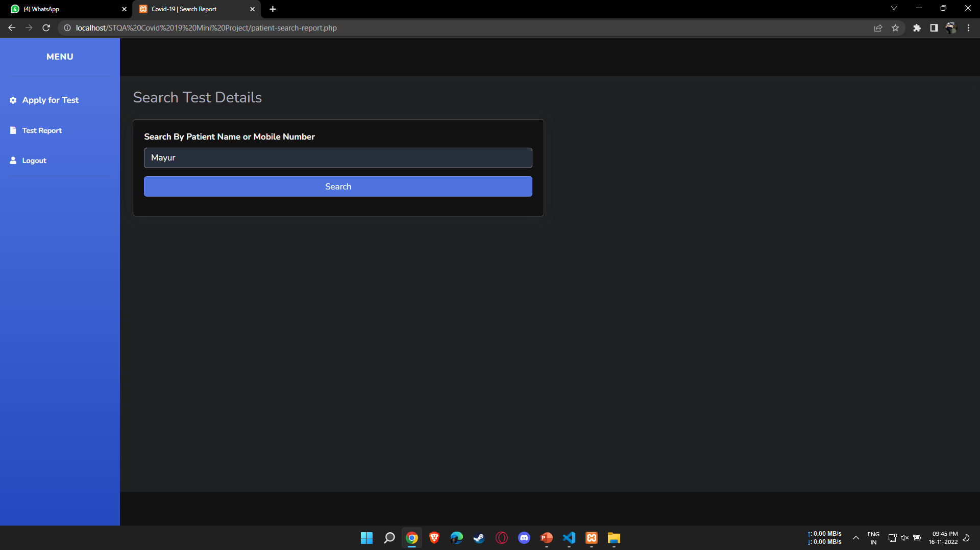
9. Searching Test Details :

Slide 15
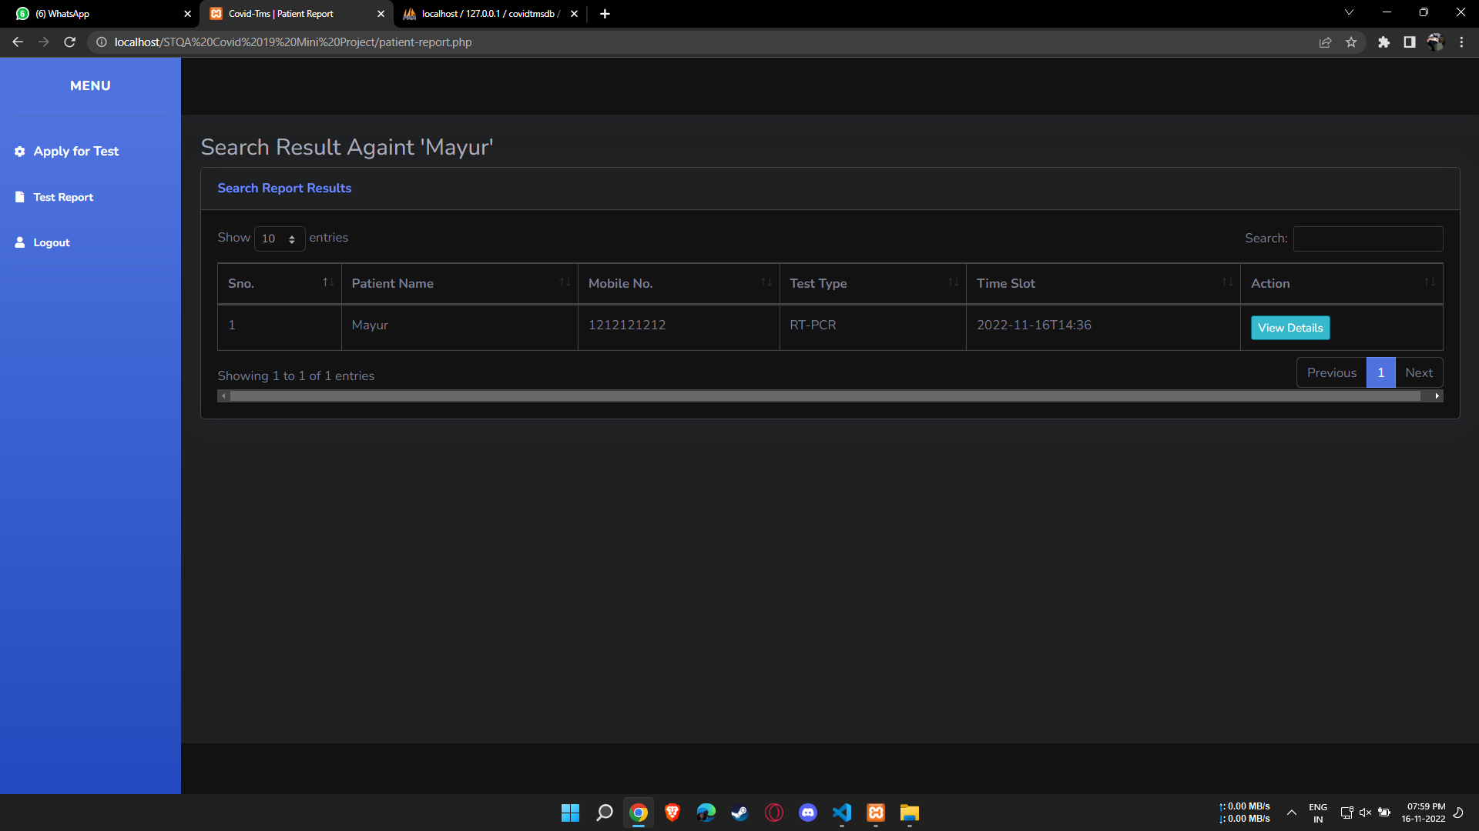
10. Output of Search :

Slide 16
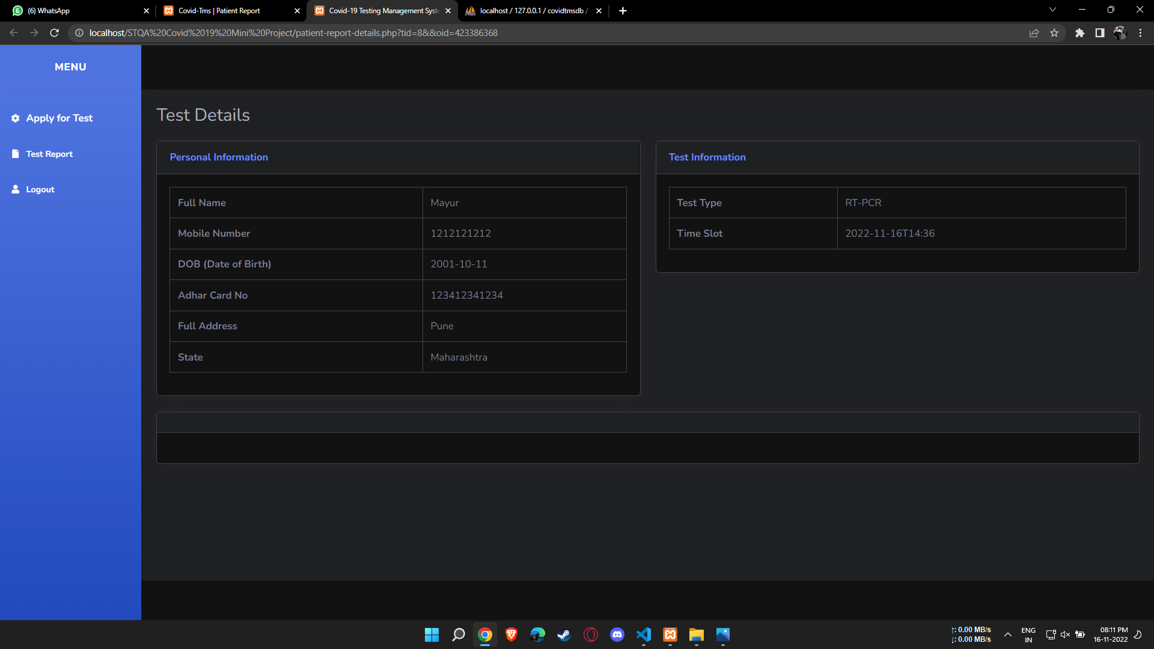
11. Test Detail Search Output:

Slide 17
Use Case Test Cases :
No. | Test Cases | Test Pass or Not
1 | Is the login page visible? | Yes
2 | Are we able to Enter the Email and Password? | Yes
3 | Does Password Hides after we type it? | Yes
4 | Does Login button redirects to proper page after we click on it? | Yes
5 | Does Full Name Textbox takes only Character String as input? | Yes
6 | Does Mobile Number Takes only 10 Numbers and gives right prompt if we Enter wrong format? | Yes
7 | Are we able to Select Date of Birth? | Yes

Slide 18
No. | Test Cases | Test Pass or Not
8 | Does Aadhar Card No Takes only 12 Numbers and gives right prompt if we Enter wrong format? | Yes
9 | Are we able to fill Address , State ? | Yes
10 | Are we able to Select Test type and Time slot? | Yes
11 | Is submit Button working Properly and gives us proper Prompt? | Yes
12 | Are we able to enter the patient name / Mobile No. to search details? | Yes
13 | Are we getting the proper search result after clicking search button? | Yes
14 | Are we able to see details after clicking on detail button? | Yes

Slide 19
Conclusion
Thus , We were able to create a dynamic website of Covid-19 information and were also able to test it using Regular Expression as well as Use case Test Cases .

